Slide 1

QTM 531 Computing II
Dr. Alejandro Sánchez Becerra

Slide 2
Agenda
Introductions
CLASS DETAILS
COMPUTING Environment

Slide 3
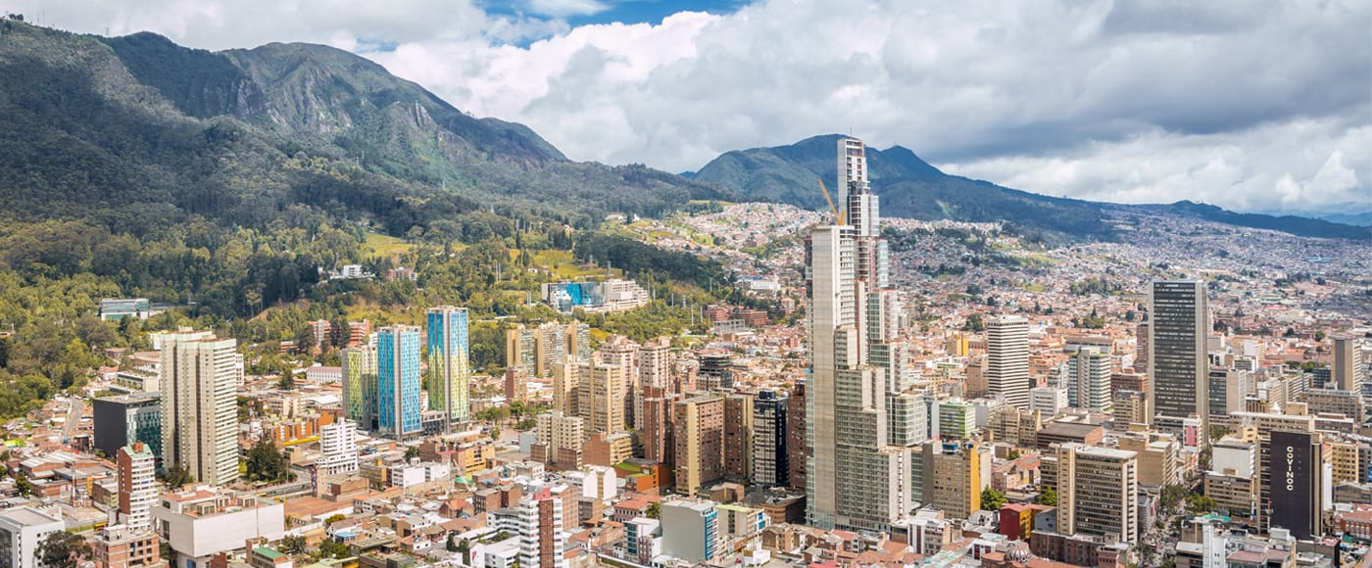
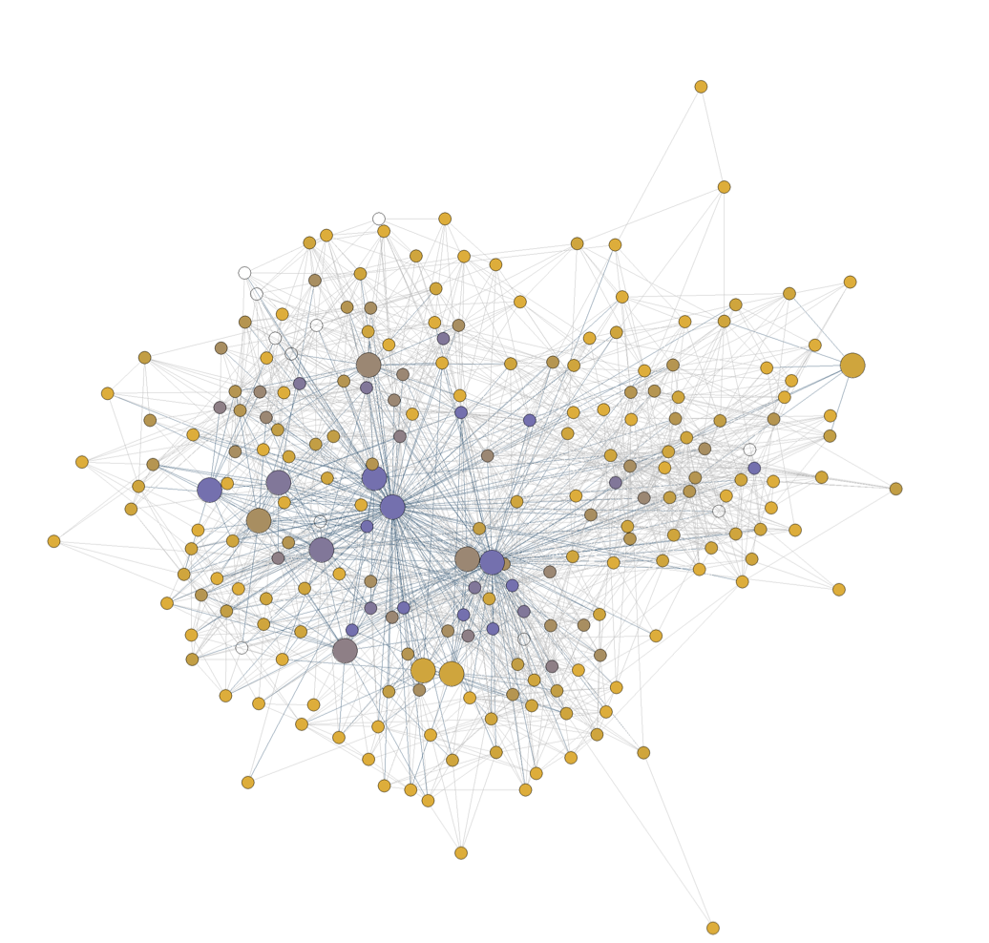
About me
My name is Alejandro Sánchez Becerra
I did my Ph.D. in Economics at the University of Pennsylvania and completed a post-doc at New York University.
I’m originally from Colombia
My research focuses on causal inference, machine learning, and network analysis. I focus on applications that evaluate poverty-reduction programs

Slide 4

My teaching philosophy
I like an interactive class where I engage with the students
Come to my office hours with questions so I can get to know you!
We will also constantly do “try it yourself” exercises

Slide 5
Agenda
Introductions
CLASS DETAILS
COMPUTING Environment

Slide 6



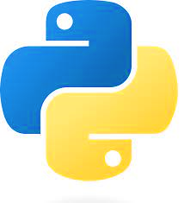
Our class in a nutshell …
Virtual Environment
+
Python
VS Code Interactive Development Environment (IDE)
Environment where the user writes the scripts
Script File
File with code in the Python programming language.
Instructions for the program to follow
(in background)
Programming language we use to write the instructions

Slide 7
Installing Python using Anaconda
Follow the instructions Installing Python Using Anaconda from Canvas
We are using Anaconda virtual environments for this class (I will cover this in more detail next class)
For now: Anaconda comes with a Python installation
Questions?

Slide 8
Installing VS code and connecting Anaconda
Follow the instructions Installing Visual Studio Code and Connecting it with Anaconda from Canvas
For now: know that “base” is the default Anaconda virtual environment that comes by default with the installation
The next step is to check if the connection between VS code and Anaconda worked → the Python: Select Interpreter option should include Python (‘base’)

Slide 9
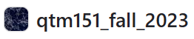

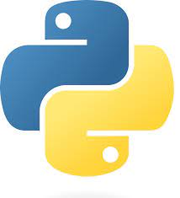

Lecture Notes
+
Python
VS Code
Github:
A file management system in the cloud (with desktop app)
Has version control
Great for collaborative programming

